Slide 1


Excerpts
SINPHONIE
26 Nov 2012
EPAR
Inserm UMR-S 707 – UMPC Paris 6
France

Slide 2
Prime statistics
No. of countries: 23
No. of cities: at least 54 (many missing data)
No. of schools: 107*
No. of classrooms: 319*
No. of parents** of pupils: 5,175
Of which, pre-school children: 264 (5.1%)
No. of teachers: 1,223
Notes:
* Considering only those pupils in the child-qp dataset; otherwise physico-chemical and biological measurements were also made in some classrooms from which no pupils were enrolled or had data.
** Parents = father and/or mother together as a single unit replying to the child-qp form.

Slide 3
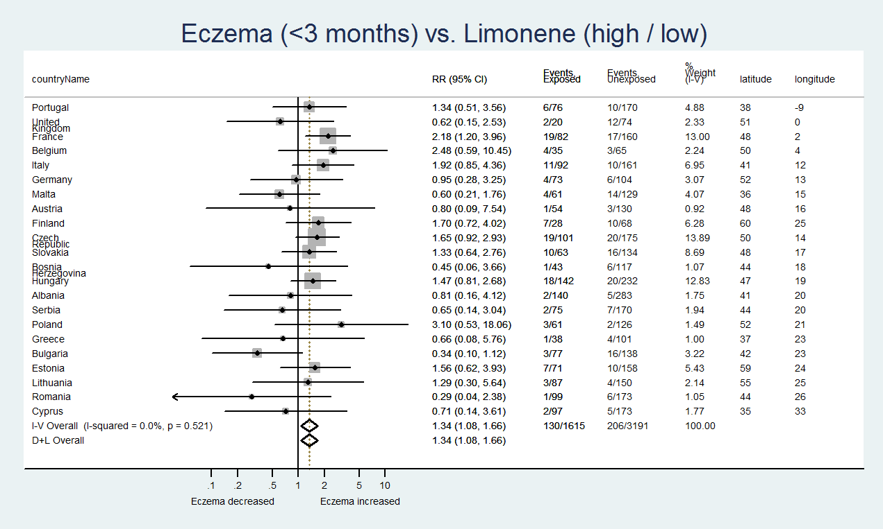
Heterogeneity chi-squared = 20.0 (d.f. = 21) p = 0.521
I-squared (variation in RR attributable to heterogeneity) = 0.0%
Test of RR = 1 : z = 2.64 p = 0.008

Slide 4
Pollutant | No. classrooms Mean Std. Dev. Min Max
-------------+-----------------------------------------------------
Formaldehyde | 316 15.14 10.14 1.3 66.2
Notes:
Horizontal white bar = Median.

Slide 5
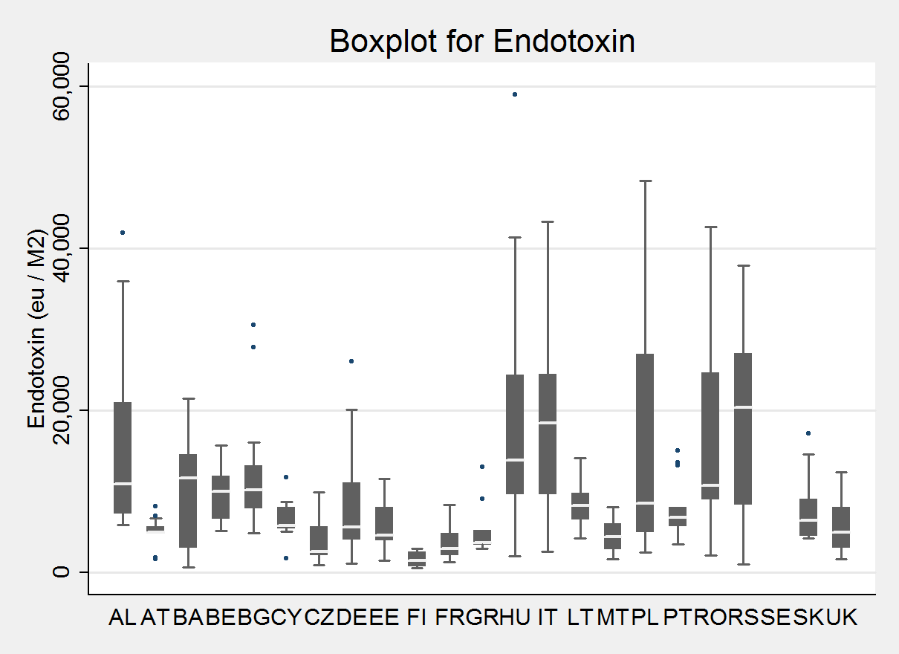
Biotoxin | No. classrooms Mean Std. Dev. Min Max
-------------+-------------------------------------------------------------
Endotoxin | 297 9953.424 9417.852 496 59000

Slide 6
Table showing the pooled prevalence_{meta} rates (%) ± 95% CIs of ISAAC symptoms in school children as reported by their parents using meta-analytic techniques (inverse variance-weighted method) for the participating countries
Symptom | N | Prevalence_{meta} (%) | 95% LCL | 95% UCL
Ever wheeze | 5,064 | 23.2 | 22.1 | 24.4
Wheeze (< 12 months) | 5,064 | 8.4 | 7.6 | 9.1
Wheeze (< 30 days) | 5,064 | 2.1 | 1.7 | 2.5
Doctor-diagnosed asthma | 5,004 | 7.6 | 6.9 | 8.3
Asthma-in-school | 5,004 | 1.2 | 0.9 | 1.5
Ever runny / blocked nose† | 5,050 | 25.0 | 23.8 | 26.2
Ever nasal allergy | 5,069 | 13.2 | 12.3 | 14.1
Nasal allergy (< 12 months) | 5,050 | 20.8 | 19.6 | 21.8
Doctor-diagnosed nasal allergy | 5,069 | 8.9 | 8.1 | 9.6
Eye irritation (< 12 months) | 5,050 | 8.2 | 7.5 | 9.0
Itchy rash (< 6 months) | 5,017 | 13.8 | 12.9 | 14.7
Ever eczema | 5,000 | 16.8 | 15.8 | 17.8
Dry cough (< 12 months) | 4,917 | 18.8 | 17.7 | 19.9
Cough episodes | 5,053 | 9.3 | 8.5 | 10.1
Phlegm episodes | 5,019 | 5.9 | 5.3 | 6.6
See next slide under “Total”, expanded by country
LCL: Lower Confidence Limit; UCL: Upper Confidence Limit
† Not occurring due to cold

